Slide 1
Identifying Viable Restaurant Locations in Las Vegas

Slide 2
Location is Key to Success for Restaurants
Many factors impact a restaurant’s success
Location is a key factor
Highly populated areas with other non-restaurant businesses can support a restaurant
High concentration of similar restaurants can lead to increased competition
Owners need to be located nearby in the event of an emergency or if extra assistance is required – proximity to the owner’s residence is important

Slide 3
Data Acquisition and Cleaning
Foursquare API
Venue information for Las Vegas area restaurants
GeoPostcodes
Las Vegas neighborhood and zip code data
Opendatasoft (ODS)
Geo coordinate data for each Las Vegas neighborhood
Data Cleaning
Focus on neighborhoods in/near the Las Vegas area
Exclude neighborhoods from other parts of Nevada
Clean data set included 130 columns representing venues by neighborhood

Slide 4
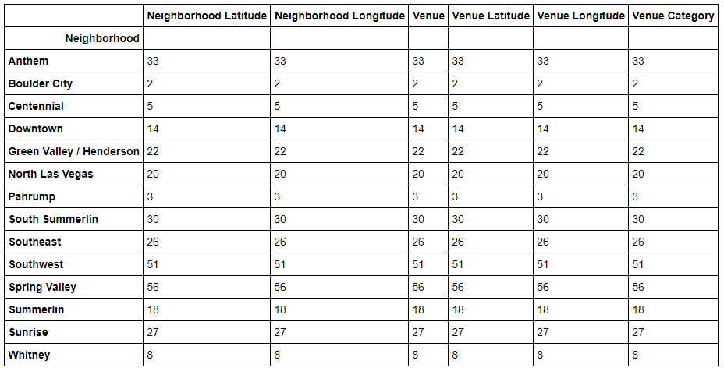
Top Neighborhoods Fit Criteria
Top neighborhoods by count of venue categories fit the initial criteria (location + nearby businesses)

Slide 5
Conclusion
Provided useful neighborhood analysis to determine best neighborhoods and zip codes to open an Asian-themed restaurant in Las Vegas
Further analysis could reveal:
Ideal locations for a 2nd restaurant
Corporate/business location analysis to assess viability of offering catering services to nearby offices

